Slide 1
Network Flow
Kamiar Asgari

Slide 2
True/False

Slide 3
True/False
True!

Slide 4
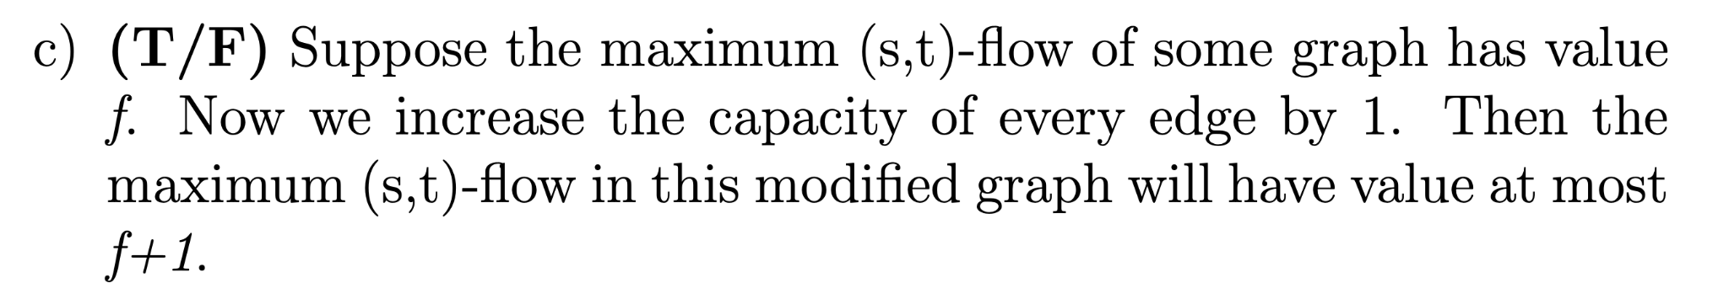
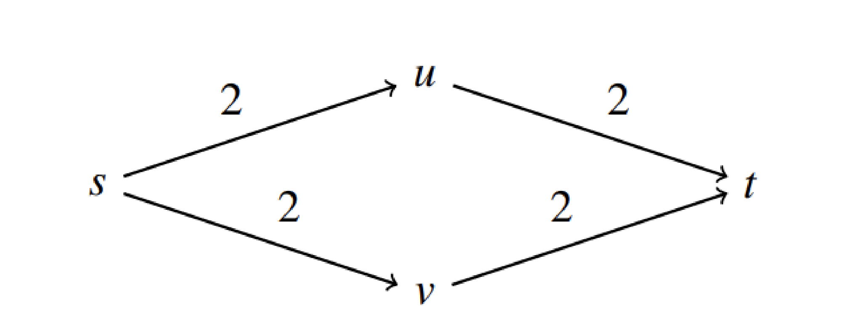
True/False
False. Consider the counterexample.

Slide 5
T/F Question
For any edge e that is part of the minimum cut in G, if we increase the capacity of that edge by any integer k > 1, then that edge will no longer be part of the minimum cut.

Slide 6
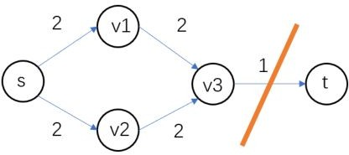
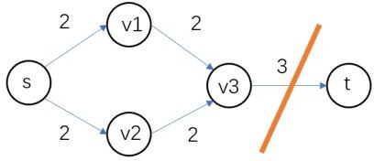
T/F Question
For any edge e that is part of the minimum cut in G, if we increase the capacity of that edge by any integer k > 1, then that edge will no longer be part of the minimum cut.
False.
Counter Example for k = 2

Slide 7
Multiple choices
https://www.cs.princeton.edu/~wayne/kleinberg-tardos/pdf/

Slide 8
What is the capacity of the cut { A, E, F, G } ?
11 (20 + 25 − 8 − 11 − 9 − 6)
34 (8 + 11 + 9 + 6)
45 (20 + 25)
79 (20 + 25 + 8 + 11 + 9 + 6)
capacity of cut involves only edges from set { A, E, F, G } to { B, C, D, H}
(not from { B, C, D, H} to set { A, E, F, G })
source
capacity
A
20
B
8
C
10
D
6
12
8
11
9
6
8
E
1
F
16
G
25
H
target

Slide 9
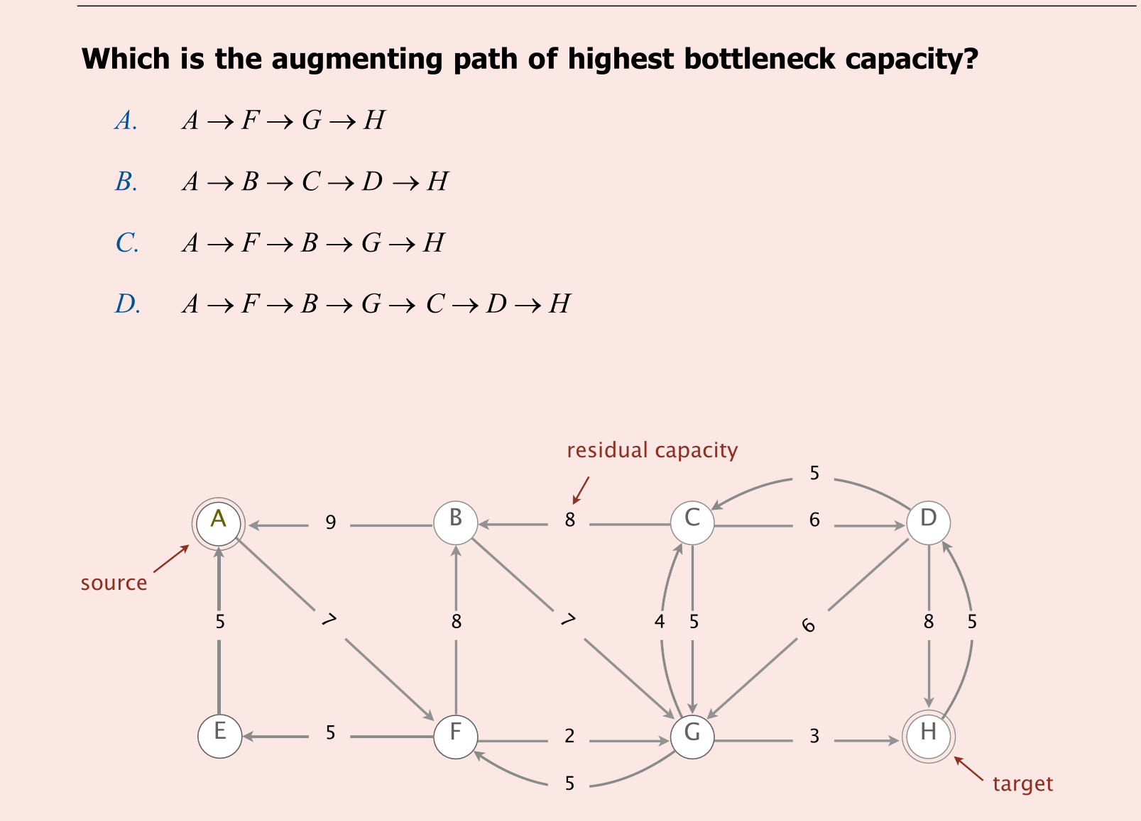

Slide 10
Given the flow f below, what is the net flow across the cut { A, E, F, G }?
11 (20 + 25 − 8 − 11 − 9 − 6)
26 (20 + 22 − 8 − 4 − 4 − 0)
42 (20 + 22)
45 (20 + 25)
net flow adds and subtracts flows, not capacities
net flow calculation involves both edges from A to B and from B to A
capacity of cut
flow
capacity
A
20 / 20
B
8 / 8
C
4 / 10
D
source
1 / 6
5 / 12
8 / 8
4 / 11
4 / 9
0 / 6
4 / 8
E
1 / 1
F
14 / 16
G
22 / 25
H
target
31

Slide 11
In the worst case, how many augmenting paths does the Ford–Fulkerson algorithm consider in order to find a perfect matching in a bipartite graph with n vertices per side?
Θ(n)
Θ(n ²)
Θ(n ³)
Θ(n ⁴)
value of flow ≤ n

Slide 12
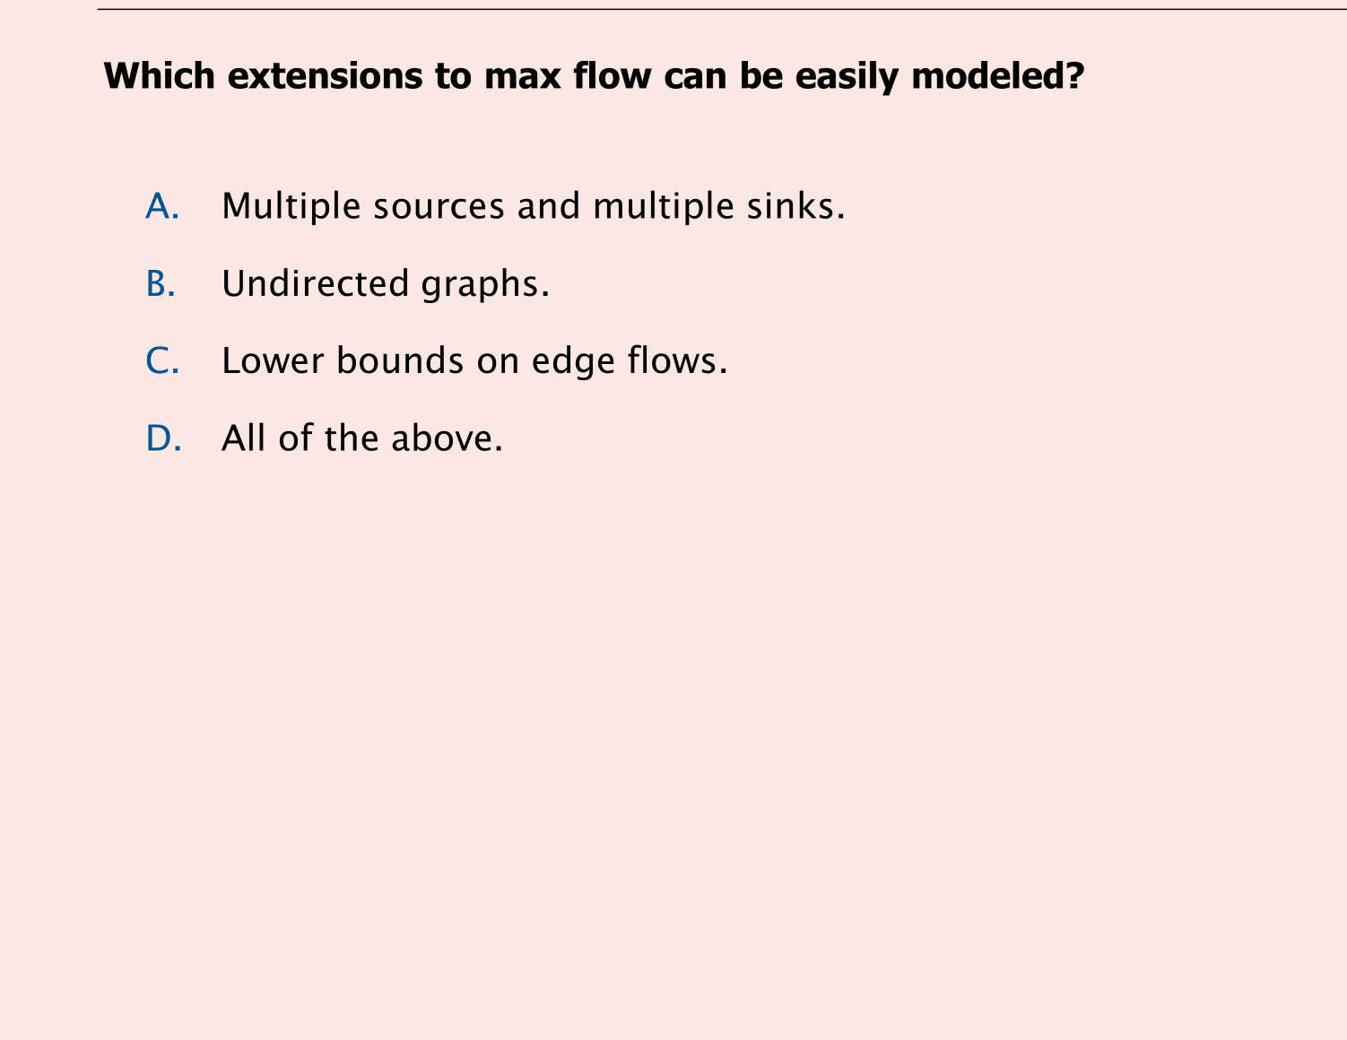

Slide 13
Which is an augmenting path?
A → F → G → D → H
A → F → B → G → C → D → H
Both A and B.
Neither A nor B.
flow
capacity
A
20 / 20
B
8 / 8
C
4 / 10
D
source
1 / 6
5 / 12
8 / 8
4 / 11
4 / 9
0 / 6
4 / 9
E
1 / 1
F
14 / 16
G
22 / 25
H
target
23

Slide 14
What is the bottleneck capacity of the augmenting path A → F → B → G → C → D → H ?
A. 4
B. 5
C. 6
D. 7
can reduce flow on edge C→G by at most 4
flow
capacity
A
20 / 20
B
8 / 8
C
4 / 10
D
source
1 / 6
5 / 12
8 / 8
4 / 11
4 / 9
0 / 6
4 / 9
E
1 / 1
F
14 / 16
G
22 / 25
H
target
25

Slide 15
Given the following maxflow, which is a mincut?
{ A, F }, {B,C, D, E, G, H }.
{ A, B, C, F }, { D, E, G, H }.
{ A, B, C, E, F }, { D, G, H }.
None of the above.
flow
capacity
A
20 / 20
B
8 / 9
C
8 / 8
D
source
2 / 2
11 / 13
4 / 8
8 / 8
0 / 9
0 / 6
8 / 8
E
2 / 2
F
17 / 17
G
25 / 26
H
target

Slide 16
Question

Slide 17
You are employed at a video game company, which is preparing to release n distinct types of video games. Before their release, these games need to be tested. There are m players available for testing, where m ≥ n. Each game type appeals to a specific subset of these players P[i]. The goal is to distribute these n game types among the players for testing, adhering to the following conditions:
a) Each game type should only be given to players who have shown interest in that specific type. b) A player can test a maximum of k different game types. c) No player should receive the same game type more than once. d) The objective is to maximize the total maximize the number of tests
Design an efficient network flow-based algorithm for this problem. You are required to make a claim regarding the correctness of your algorithm and provide proofs in both directions to support your claim.

Slide 18
Step 1: Nodes
Look into the objects in the problem statement.
You are employed at a video game company, which is preparing to release n distinct types of video games. Before their release, these games need to be tested. There are m players available for testing, where m ≥ n. Each game type appeals to a specific subset of these players P[i]. The goal is to distribute these n game types among the players for testing, adhering to the following conditions:
Two kinds of nodes: game types, and players.
The players need to “test” the game types. The relationship “test” can be regarded as one kind of edges. Importantly, one test of the player to the game type is regarded as one unit of flow.

Slide 19
Step 2: Constraints
Only the players in set P[i] can test game type i
Look into the related constraints in the problem statement.
You are employed at a video game company, which is preparing to release n distinct types of video games. Before their release, these games need to be tested. There are m players available for testing, where m ≥ n. Each game type appeals to a specific subset of these players P[i]. The goal is to distribute these n game types among the players for testing, adhering to the following conditions:
a) Each game type should only be given to players who have shown interest in that specific type. b) A player can test a maximum of k different game types. c) No player should receive the same game type more than once.
A player can test at most K game types
A player at most tests a game type once

Slide 20
Step 3: Convert Constraints
Constraint 1: only the players in P[i] can test game type i
=> create edges from game type i to the players in P[i]
Constraint 2: a player can test at most K different game
=> create edges from player to sink
set the capacity of these edges to K
Usually, if the constraint is only related to one type of nodes, the converted edges would be linked with source of sink node.
Constraint 3: a player at most tests a game type once
=> set the capacity for edges between game types and players to 1.

Slide 21
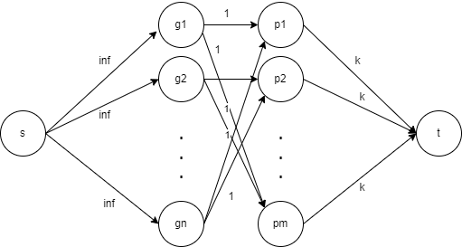
Step 4: Objective, and Other Edges
d) The objective is to maximize the total maximize the number of tests
Set the capacity to infinity

Slide 22
Follow Up Question
If the objective is to maximize the number of tested game types, what modifications do we need to make?
Set the capacity to 1

Slide 23
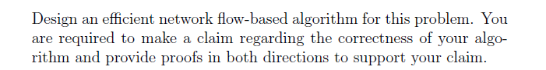
Proof
Don’t forget to prove the correctness of your designed algorithm!
The claim is required! Usually, “the desired answer of this question is equal to the maxflow (or sth else) of the constructed graph G.
Proofs in both directions.
You need to show that:
(1) If desired answer of this question is A, then the maxflow equals to A;
(2) if the maxflow is A, then the desired answer is A.

Slide 24
Proof
Claim: We can maximize the total number of video games given if and only if we maximize the flow in graph G.
Forward: Any flow translates to a valid solution (satisfying all the constraints)
Backward: Any valid solution to the distribution problem can be mapped to a valid flow for the graph.
Flow out of s is the total number of games distributed. Therefore, we maximize the total number of games distributed for testing.

Slide 25
Circulation

Slide 26
Circulation with Demands and Lower Bounds
Given a directed graph G = (V, E), demands d(v) for each vertex v, and lower bounds l(e) and capacities c(e) for each edge e, the circulation problem asks you to find a flow f such that:
f ^{in} (v) - f ^{out} (v) = d(v) for all v ∈ V
l(e) ≤ f(e) ≤ c(e) for all e ∈ E
d(v)
l(e)
c(e)
-10
A
[6,9]
[1,4]
[0,2]
B
1
3
C
[2,4]
[0,2]
6
D

Slide 27
Finding Circulation
Solution
Set flow f₁(e) = l(e) for all edges e
f₁(e)
-10
A
6
1
0
B
1
3
C
2
0
6
D

Slide 28
Finding Circulation
Solution
Set flow f₁(e) = l(e) for all edges e
Calculate the imbalance L(v) at each vertex v L(v) = f₁^{in} (v) - f₁^{out} (v)
A
L(v) = -7
-10
6
1
B
0
C
L(v) = 4
1
3
L(v) = 1
2
0
6
D
L(v) = 2

Slide 29
Finding Circulation
Solution
Set new demand d ^{new}(v) for each vertex v d ^{new}(v) = d ^{old}(v) - L(v)
A
d(v) = -10 - (-7) = -3
-3
6
1
B
0
C
d(v) = 1 - 4 = -3
-3
2
L(v) = 3 - 1 = 2
2
0
4
D
L(v) = 6 - 2 = 4

Slide 30
Finding Circulation
Solution
Set new demand d ^{new}(v) for each vertex v d ^{new}(v) = d ^{old}(v) - L(v)
Set new capacity c ^{new}(e) for each edge e c ^{new}(e) = c ^{old}(e) - l(e)
-3
A
9 - 6 = 3
4 - 1 = 3
2 - 0 = 2
B
-3
2
C
4 - 2 = 2
2 - 0 = 2
4
D

Slide 31
Finding Circulation
Solution
We have converted the problem of finding circulation with demands + lower bounds to finding circulation with demands only
d ^{new}(v)
c ^{new}(e)
-3
A
3
3
2
B
-3
2
C
2
2
4
D

Slide 32
Finding Circulation
Solution
Connect vertices with negative demands to supersource s, and vertices with positive demands with supersink t V = V U {s, t} E = E U { (s, u) | d(u) < 0 } U { (v, t) | d(v) > 0}
s
-3
A
3
3
2
B
-3
2
C
2
2
4
D
t

Slide 33
Finding Circulation
Solution
Set c(s, u) = -d(u) and c(v, t) = d(v) Set d(v) = 0 for all vertex v ∈ V - {s, t}
s
3
A
3
3
3
2
B
C
2
2
2
D
4
t

Slide 34
Finding Circulation
Solution
Set c(s, u) = -d(u) and c(v, t) = d(v) Set d(v) = 0 for all vertex v ∈ V - {s, t}
Find maximum flow f₂ in the new network
f₁(e)
s
3/3
A
3/3
1/3
2/3
2/2
B
C
2/2
2/2
2/2
D
4/4
t

Slide 35
Finding Circulation
Solution
Set f = f₁ + f₂ Remove s and t The flow f is the solution
f₁(e)
f₂(e)
f(e)
-10
A
6 + 1 = 7
1 + 2 = 3
0 + 2 = 2
B
1
3
C
2 + 2 = 4
0 + 2 = 2
6
D

Slide 36
Question

Slide 37
Problem
This Fall and Spring semesters, n students want to graduate. There are m total courses. Following conditions should be met across both semesters:
Student i must take r_{i} number of courses.
Student i must take courses belonging to set T_{i} .
Course j needs p_{j} number of students to start the course, no more or less.
Courses in set U are offered in both semesters and can be taken at most twice. All other courses are offered in one of the semesters and can be taken at most once. Taking a course in set U twice will contribute two units towards the total number of courses taken by the student.
Please design an algorithm to determine if all students can graduate.

Slide 38
Solution
We will solve this problem by finding a feasible circulation in a flow network.
Create n vertices for students, and m vertices for courses. Add an edge from each student vertex to course vertex.
Students
Courses

Slide 39
Solution
Student i must take r_{i} number of courses. Therefore, put a demand of -r_{i} on student vertex i. Course j needs p_{j} number of students to start the course. Therefore, we put a demand of p_{j} on course vertex j.
-r₁
p₁
-r₂
p₂
-r₃
p₃
-r₄
Students
Courses

Slide 40
Solution
Courses in set U can be taken at most twice. All other courses can be taken at most once. Therefore, we put a capacity of 2 on edges adjacent to a course vertex ∈ U, and a capacity of 1 on all other edges.
c(e) = 1
-r₁
p₁
-r₂
p₂
-r₃
p₃
-r₄
c(e) = 2
Students
Courses

Slide 41
Solution
Student i must take specific compulsory courses belonging to set T_{i} .
We put a lower bound of 1 on edges (i, j) if j ∈ T_{i}
c(e) = 1
-r₁
p₁
-r₂
p₂
-r₃
l(e) = 1
p₃
-r₄
c(e) = 2
Students
Courses

Slide 42
Solution
We solve the circulation with demands and lower bounds using the method we discussed earlier
c(e) = 1
-r₁
p₁
-r₂
p₂
-r₃
l(e) = 1
p₃
-r₄
c(e) = 2
Students
Courses

